Slide 1
A One Stop Solution focusing on Tourism
PIP2001 Capstone Project
Review-3
Batch Number:
Roll Number | Student Name
20211CSE0483 | JALADANGI ABDULLA
20221LCS0025 20211CSE0293 | MD MAAZ SYED TASEEN SAQQUAF
Under the Supervision of,
Ms. Galiveeti Poornima
Assistant Professor
School of Computer Science and Engineering
Presidency University
Name of the Program: CSE
Name of the HoD: Dr.Asif Mohammed H.B
Name of the Program Project Coordinator: Mr. Amarnath J.L & Dr. Jayanthi. K.
Name of the School Project Coordinators: Dr. Sampath A K / Dr. Abdul Khadar A / Mr. Md Ziaur Rahman

Slide 2
Content | Index
Hardware and Software Requirements
Architecture
Modules
UML Diagram
Timeline of the project ( Gantt Chart)
Conclusion
Abstract
Objective of project
Problem Statement
github link
Introduction
Existing Method
Disadvantages
Proposed method
Advantages

Slide 3
Abstract and Objective of project
ABSTARCT:
This project presents a one-stop solution for events, and cab bookings. It aims to streamline the booking process for users while providing administrators with the ability to manage and track bookings. The system offers functionalities such as adding and viewing details, event scheduling, and cab bookings. The user interface allows easy registration, login, and browsing of available services. Administrators can manage the backend by adding s, events, and cabs, along with monitoring bookings. The user can book s, events, and cabs, and also update booking titles when necessary. By simplifying booking processes, this system enhances convenience and efficiency for both users and admins. This project demonstrates the potential of an integrated solution to manage diverse services in one platform.
Keywords: Event scheduling, Cab reservations, User registration, Admin management, Backend tracking
OBJECTIVE OF PROJECT :
The project's main objective is to develop an integrated system where users can easily register, book events, and cabs. Administrators can manage bookings, add services, and track all activities efficiently. The system enhances user experience and administrative control.

Slide 4
Github Link
Github Link
https://github.com/Abdulla2403/A-One-Stop-Solution-focusing-on-Tourism

Slide 5
INTRODUCTION
This project offers a comprehensive solution to simplify the process of booking s, events, and cabs. It aims to enhance user convenience by integrating multiple services into a single platform. Through an easy-to-use interface, users can register, book, and view their reservations, while administrators can manage services and monitor bookings. The system is developed using the Kotlin framework for Android.

Slide 6
Existing method and Disadvantages in it
In the current scenario, users rely on separate platforms for booking s, events, and cabs, which can be inefficient and time-consuming. These systems often lack integration, making it difficult for users to track multiple bookings. Administrators also face challenges in managing these services independently, leading to potential errors and inefficiencies. A unified solution is needed to streamline these processes.
Disadvantages:
Users must navigate separate platforms for different services, leading to inefficiency.
Administrators face challenges managing bookings across multiple systems.
Lack of integration leads to potential data inconsistency and errors.
Users may experience difficulty tracking all their bookings in one place

Slide 7
Proposed method and Advantages in it
The proposed system aims to provide a unified platform where users can book s, events, and cabs in one place. Administrators can easily manage bookings, add new services, and track all activities from a single interface. This solution streamlines the entire process, reducing time and effort for users while offering a more efficient way for administrators to manage services.
Advantages:
• A single platform for managing multiple services, reducing complexity.
• Simplified booking process for users, enhancing convenience.
• Easy management of bookings and services for administrators.
• Improved tracking and monitoring of bookings, reducing errors.

Slide 8
HARDWARE & SOFTWARE REQUIREMENTS
SOFTWARE REQUIREMENS
Operating System - Windows 10
JDK - Java(kotlin)
SDK - Android
IDE - Android studio
Database - my SQL
HARDWARE REQUIREMENTS
Processor - I3/Intel Processor
RAM - 8 GB
Hard Disk - 1TB

Slide 9
Modules
Cab Module:
Users select cab options. They can track bookings, update information, and ensuring a flexible and user-friendly experience for travel.
Admin Flow : Admins manage events, and cabs by adding, updating, and tracking bookings. They monitor customer queries, generate reports, and ensure smooth operations, providing an organized backend for the platform.
User Module:
Users register, log in, and explore available services. They can book events and cabs, manage bookings and track their reservations. The flow ensures a seamless, efficient booking process..
Events Module:
Users browse and book events. They can view event details, track reservation status, offering flexibility in managing their event participation.

Slide 10
UML DIAGRAMS
Use Case Diagram:
A use case diagram in the Unified Modeling Language (UML) is a type of behavioral diagram defined by and created from a Use-case analysis. Its purpose is to present a graphical overview of the functionality provided by a system in terms of actors, their goals (represented as use cases), and any dependencies between those use cases. The main purpose of a use case diagram is to show what system functions are performed for which actor. Roles of the actors in the system can be depicted.

Slide 11
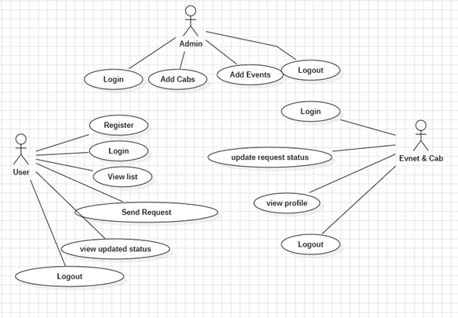
UML DIAGRAMS
Figure: Use Case Diagram

Slide 12
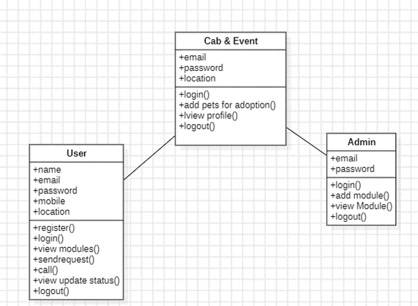
Class Diagram:
In software engineering, a class diagram in the Unified Modelling Language (UML) is a type of static structure diagram that describes the structure of a system by showing the system's classes, their attributes, operations (or methods), and the relationships among the classes. It explains which class contains information.

Slide 13
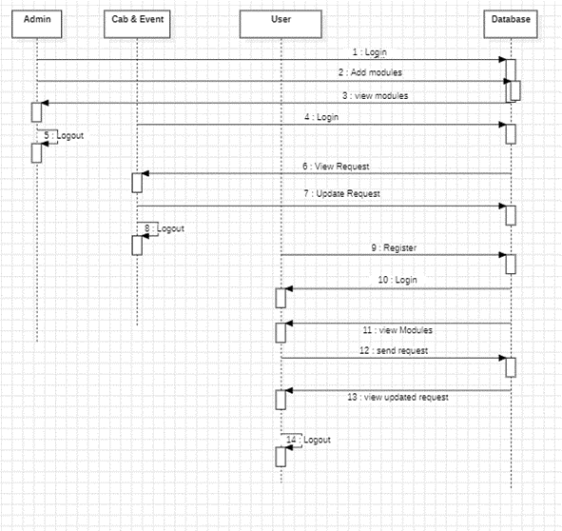
Sequence Diagram:
A sequence diagram in Unified Modelling Language (UML) is a kind of interaction diagram that shows how processes operate with one another and in what order. It is a construct of a Message Sequence Chart. Sequence diagrams are sometimes called event diagrams, event scenarios, and timing diagrams.

Slide 14
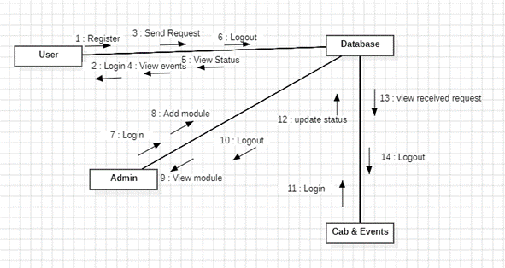
Collaboration Diagram:
In collaboration diagram the method call sequence is indicated by some numbering technique as shown below. The number indicates how the methods are called one after another. We have taken the same order management system to describe the collaboration diagram. The method calls are similar to that of a sequence diagram. But the difference is that the sequence diagram does not describe the object organization whereas the collaboration diagram shows the object organization.

Slide 15
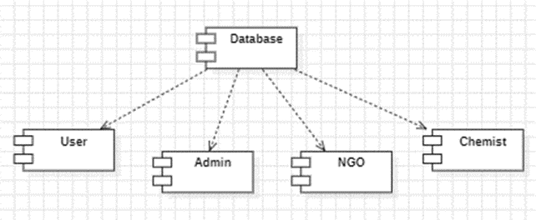
Deployment Diagram
Deployment diagram represents the deployment view of a system. It is related to the component diagram. Because the components are deployed using the deployment diagrams. A deployment diagram consists of nodes. Nodes are nothing but physical hardware’s used to deploy the application.

Slide 16
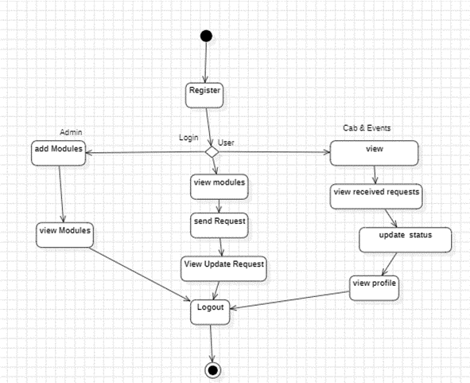
Activity Diagram:
Activity diagrams are graphical representations of workflows of stepwise activities and actions with support for choice, iteration and concurrency. In the Unified Modelling Language, activity diagrams can be used to describe the business and operational step-by-step workflows of components in a system. An activity diagram shows the overall flow of control.

Slide 17
Component Diagram:
A component diagram, also known as a UML component diagram, describes the organization and wiring of the physical components in a system. Component diagrams are often drawn to help model implementation details and double-check that every aspect of the system's required functions is covered by planned development.

Slide 18
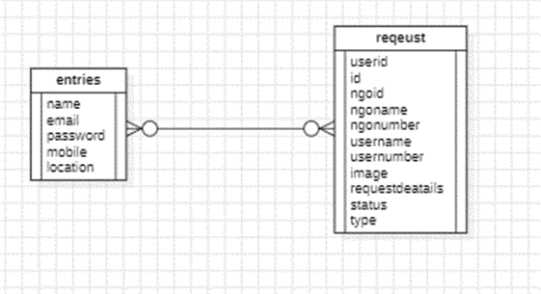
ER Diagram:
An Entity–relationship model (ER model) describes the structure of a database with the help of a diagram, which is known as Entity Relationship Diagram (ER Diagram). An ER model is a design or blueprint of a database that can later be implemented as a database. The main components of E-R model are: entity set and relationship set.
An ER diagram shows the relationship among entity sets. An entity set is a group of similar entities and these entities can have attributes. In terms of DBMS, an entity is a table or attribute of a table in database, so by showing relationship among tables and their attributes, ER diagram shows the complete logical structure of a database. Let’s have a look at a simple ER diagram to understand this concept.

Slide 19
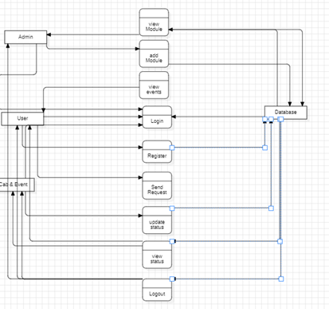
DFD Diagram:
A Data Flow Diagram (DFD) is a traditional way to visualize the information flows within a system. A neat and clear DFD can depict a good amount of the system requirements graphically. It can be manual, automated, or a combination of both. It shows how information enters and leaves the system, what changes the information and where information is stored. The purpose of a DFD is to show the scope and boundaries of a system as a whole. It may be used as a communications tool between a systems analyst and any person who plays a part in the system that acts as the starting point for redesigning a system.

Slide 20
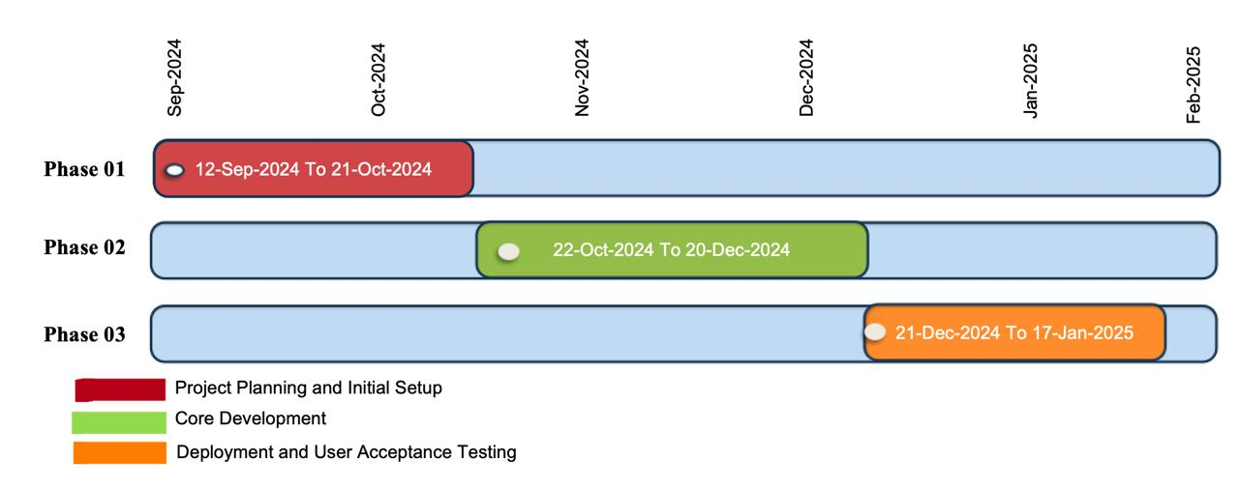
Timeline of the Project (Gantt Chart)

Slide 21
Conclusion
Conclusion: This project successfully provides a unified platform that streamlines the booking process for services, events, and cabs, enhancing user convenience and efficiency. By leveraging the Kotlin framework for Android, it ensures a seamless and intuitive experience for both users and administrators. Users can easily manage their reservations, while administrators benefit from robust tools to oversee and maintain services. This solution demonstrates the potential of technology in simplifying everyday tasks, paving the way for future advancements and scalability in integrated service platforms.

Slide 22


